Slide 1
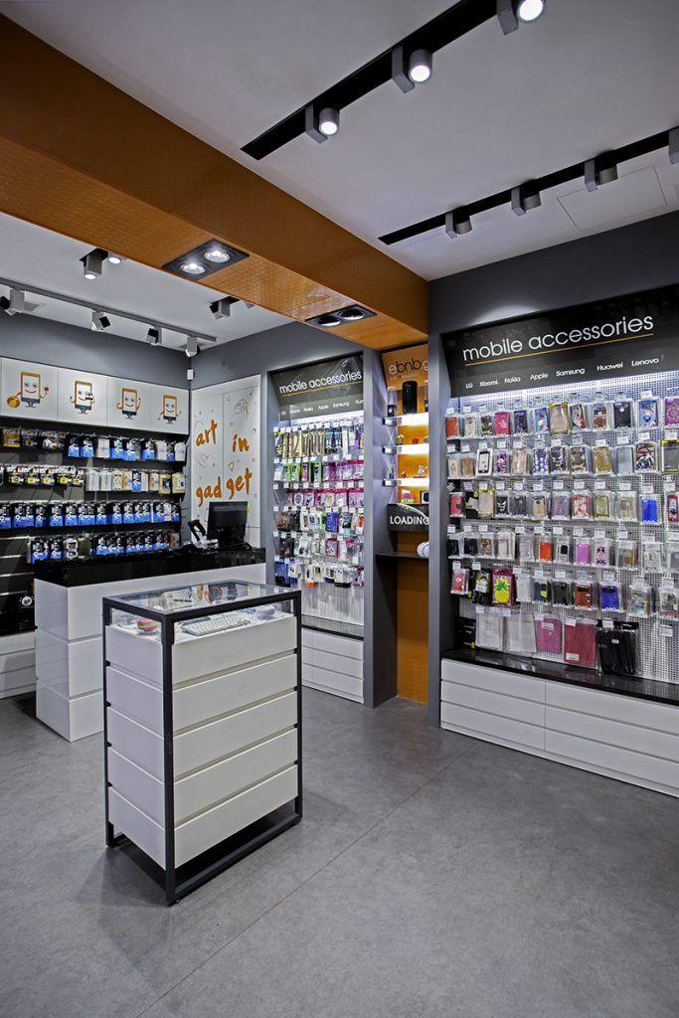
ANALYSIS REPORT FOR OPTIMUS ELITE SUPERSTORES
PRESENTED BY: TEAM 3
OLUWASEYI FOLORUNSO
AFOLABOMI OMOBOLA
ISRAEL ADEGBILE OLUWAGBEMI

Slide 2
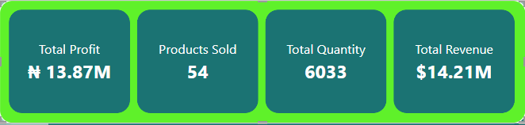
EXECUTIVE SUMMARY
Optimus-Elite Superstore, founded in 2010, has grown steadily to become a prominent player in the retail market. Specializing in a diverse range of products, the store caters to a broad customer base across various regions. With electronics to office supplies focusing on customer satisfaction and operational efficiency, Optimus-Elite Superstore prides itself on delivering quality products with a swift and reliable order fulfillment system. With the oversight of seasoned managers, the store has generated a total profit of ₦13.87 million over a span of 4 years, selling 54 different products across approximately 6 regions.

Slide 3

CONTENTS
1
Overview
2
Low Income Generating Products
3
Regional Managers Performance by Profit
4
Profit-Based product subcategory
5
Order Priority level by Profit
6
Monthly Trend by Profit

Slide 4
CONTENTS
7
Top 5 Performing States by Profit
8
Bottom 5 States by Product
9
Segment by Profit
10
Yearly Revenue Trend
11
Recommendation
12
Conclusion

Slide 5



OVERVIEW
This document presents important data using visual representations like graphs, such as the least profitable 5 products, the performance of regional managers based on profit, profit analysis by product sub-category, order priority level influence on profit, monthly profit trends, the top 5 most profitable states, the 5 least profitable states, profit analysis by customer segment, and the annual revenue trend.
The financial results of various products, including electronics and office supplies, are evaluated in this report. Additionally, the report provides an analysis of overall profits, sales performance for each product, and the performance of regional managers.
The analysis in this report was carried out with the use of Power BI. Calculations and visualizations were utilized to derive key business metrics, which are intended to guide decision-making processes.

Slide 6
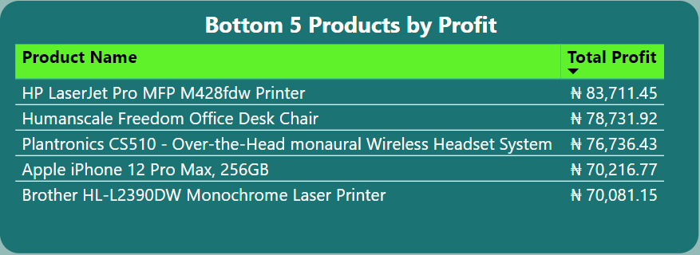
LOW INCOME GENERATING PRODUCTS
The Brother HL-L2390DW Monochrome Laser Printer has the lowest total profit, bringing in ₦70,081.15 in profit.
Among the bottom five products, the HP LaserJet Pro MFP M428fdw Printer enjoys the highest profit at ₦83,711.45.
The profit margins of these bottom five products are quite similar, spanning from ₦70,081.15 to ₦83,711.45.

Slide 7
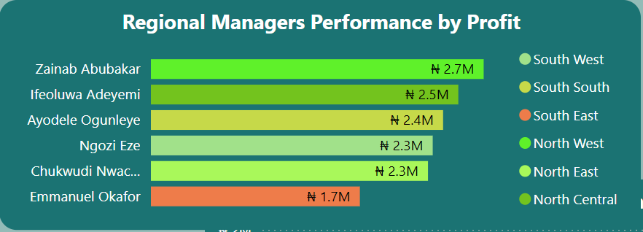
REGIONAL MANAGERS PERFORMANCE
Zainab Abubakar from the South West region generated the highest profit with a total of ₦ 2.7 million.
Emmanuel Okafor from the South East region is the least performing manager with a total profit of ₦1.7million.

Slide 8
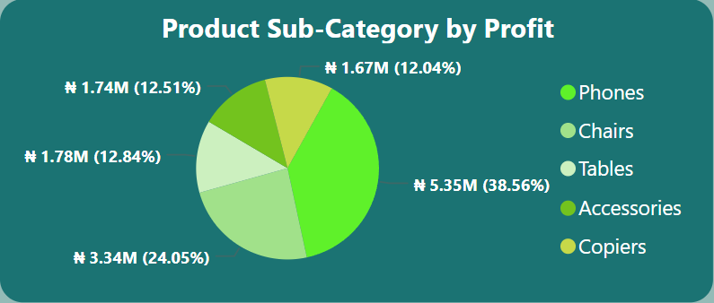
The Phones sub-category generated the highest profit with a percentage of 38.56.
Profit generated by Tables and Accessory sub-categories are within close range with a difference of 0.33 %.
PRODUCT SUB-CATEGORY BY PROFIT

Slide 9
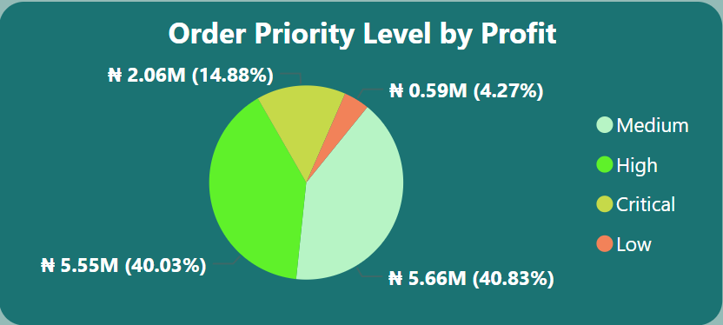
High Priority and Low Priority orders contribute the most to the total profits, nearly equally, with High Priority at 40.83% and Low Priority at 40.03%.
Medium Priority orders contribute a moderate amount to the total profits at 14.88%.
Critical Priority orders contribute the least to the total profits at 4.27%.
ORDER PRIORITY LEVEL BY PROFIT

Slide 10
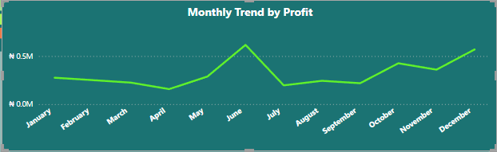
In 2013, there was a gradual decline in profits from January to April.
Profits surpassed the initial amount of ₦275,072 by May and reached the highest point in June (₦617,216).
Following June, profits dropped in July but began to rise again in August and kept increasing steadily.
MONTHLY TREND BY PROFIT

Slide 11
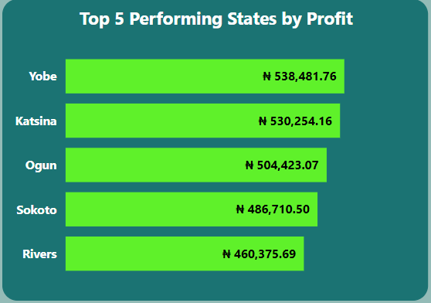
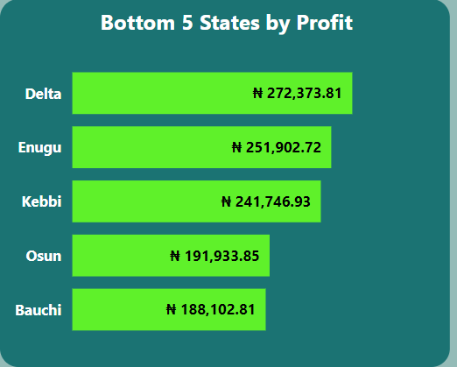
VS
The top 5 states that perform the best all produce profits that are over twice the amount generated by the bottom 5 states.
STATE COMPARISON

Slide 12
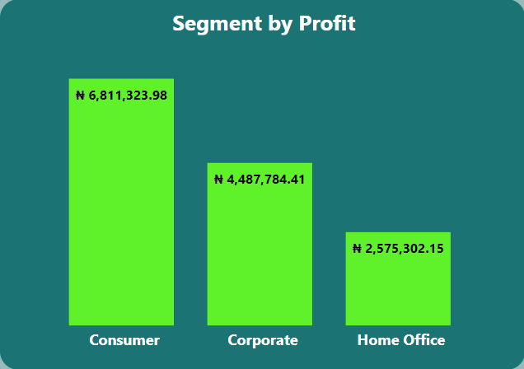
Consumer segment recorded an overall profit of ₦6.8Million which is the highest.
The least income-generating segment is the Home Office with a total of ₦2.58 Million as profit.
SEGMENT BY PROFIT

Slide 13
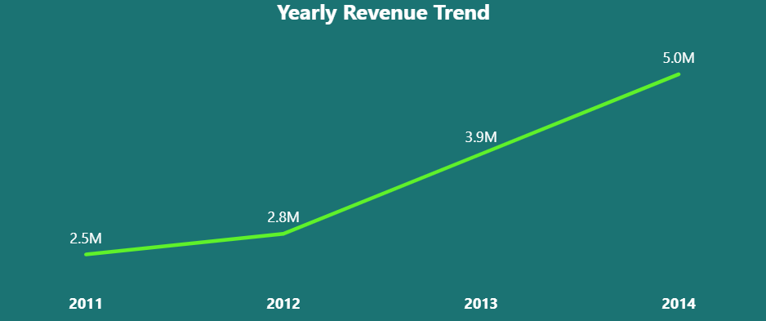
The year 2011 recorded the lowest revenue generated in the history of Optimus Elite Superstore.
In 2012, there was a slight increase in revenue by ₦300,000 compared to the previous year.
Revenue experienced a ₦1.1M increase in 2013 and displayed a continuous upward trend.
Yearly Revenue Trend

Slide 14
1. Regularly conduct thorough market research to collect insights on the most popular and top-selling printer brands, enabling well-informed decisions on stocking.
2. Launch sales promotions such as discounts and package deals to drive demand and increase sales of products with low profits.
4. The marketing department needs to create and execute targeted advertising strategies for products with a history of low profitability to enhance their visibility and boost sales.
3. Establish a monthly performance incentive scheme based on specific metrics to acknowledge and incentivize high-performing managers, thus encouraging them to excel in their roles.
RECOMMENDATI-ON

Slide 15

CONCLUSION
Our analysis indicates that Optimus Elite is a growing business, even though it has not yet garnered significant interest during its existence.
Based on the yearly revenue trend, we anticipate a continual increase in the generated revenue as the year progresses.
Furthermore, we suggest that managers in regions with low profits should implement strategies to boost sales.
The high returns in certain consumer segments demonstrate where customers are investing their money, and KPIs should be established to ensure similar returns in other segments.
Finally, the underperforming products or states serve as a warning sign that urgent action is required to ensure the success of the business and its products.

Slide 16


THANK YOU

